Slide 1
MCB Travel Workshop FY16
Presented Monday, February 29, 2016
MCB Lab Admin Forum

Slide 2
Goals of this workshop
Update on significant travel policy developments
Refresher
Uniform Guidance
(eff. Dec 26, 2014 for all Federal awards)
Sponsored Expenditures Guidelines
(eff. Dec 26, 2014 for all Federal awards)
Harvard’s Travel Policy Updates
(eff. March 1, 2016)
Notes:
FINDING THE MOST ECONOMICAL FARES
What, if anything is needed for documentation
USING DOMESTIC CARRIERS
Fly America Act
Open Skies Agreement
ESTABLISHING A FRAMEWORK AND PROCESS FOR EXCEPTIONS TO BASIC POLICIES
refundable ticket
travel insurance
business class
medical exception letters
Federal Lowest Economy Airfare Travel Reimbursement Exception Form
Fly America Travel and Reimbursement Exception Form
Alcohol on meals (required receipts)
ALLOCABILITY
Who is traveling and for what reason, how does it relate to the grant

Slide 3
Components of a business description
When (Transaction and travel dates)
Who (Individual/lab)
Where (Transaction vendor/location of transaction)
What (Goods or services received in transaction)
Why (Full description of business transaction)

Slide 4
When
Business description should include
Date of financial transaction
  For reimbursement, date expense incurred/purchase date (must be indicated on accompanying receipt or invoice)
  For Corporate Card Direct Pay: “Sale Date” on Corporate Card statement
Travel date
  Enter entire date of meeting/conference/event
POINTS OF CONSIDERATION:
Do event dates correspond to travel and/or financial transaction dates?
Do receipts correspond to event dates?
Notes:
Talking point:
These are points that approvers look for when reviewing reimbursement requests.

Slide 5
Who
Business description
Name of traveler/lab
Employee or non employee?
POINTS OF CONSIDERATION:
Status of reimbursee at the time of expense
Are the appropriate funds being charged?
For business meals with 5 or less participants, list all attendee names.
New reimbursement system: Concur (more info to come!)
Employee (Web Voucher) | Non-Employee (HCOM)
Faculty Research Associates Postdocs (6150) Staff | Temps LHTs Harvard students External Postdocs (6450, 6452) Visiting Fellows All others who are not employees
Notes:
Talking point:
Is the fund being used for travel reimbursement sponsored, and is it the same fund supporting the traveler's salary?
Was the traveler expending effort on the award being charged during date of travel?
Concur is planned to be the new platform for reimbursements; MCB members (Frank, Carol, Val, Ronnie and Nathalie) are testers – any other volunteers?

Slide 6
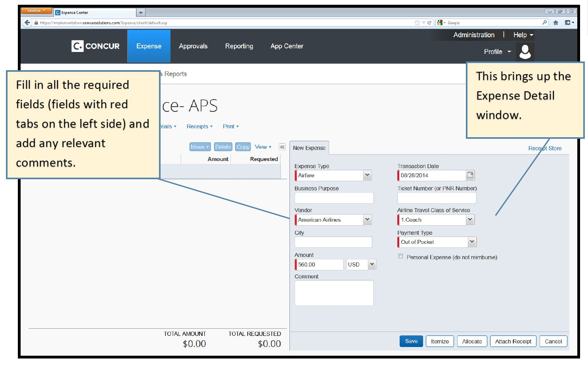
Concur - Harvard’s New Reimbursement System (coming soon)
Notes:
This is a generic screenshot of the platform.
We anticipate that the fields will map to the various components of our business description.
Features include being the uploading of receipts, and other types of back up documentation.

Slide 7
Where
Destination/location of meeting
POINTS OF CONSIDERATION:
Federal awards: Does airfare purchased to reach destination comply with Fly America Act and Open Skies Agreement?
    Refer to Harvard Financial Administration Federal Travel Regulations Tutorial (link at the end of this presentation)
Is the destination on the transaction and location of the meeting the same?
      Example: Business description includes, “Economy airfare Boston-Paris, FR to present research at 6th EMBO meeting, Manchester, UK Sept 5-8/ 2015”
      -Additional justification would be needed.
Notes:
Talking point:
Quick tip: Always check list because some countries are considered/assumed to be part of the EU when officially they are not (i.e., Turkey), and conversely when non-EU countries airlines are added to the list of Open Skies Agreement (Norway and Iceland)
Special considerations for Switzerland, Japan and Australia
For other sponsored awards, check terms for any special travel considerations, or ask PM.
Code share.

Slide 8
What
Reimbursable Expenses | Conditionally Reimbursable Expenses | Forget about it
Economy Airfare | WiFi | Alcohol
Ground transportation | Insurance on airfare | Movies
Lodging | Cancellation or change fees | Gym fee
Meals | Refundable tickets | Personal travel
Business Meals | Coach seat upgrades, business class
1st Baggage fee | Printing
 | Conference/Meeting Registration
 | Society membership
POINTS OF CONSIDERATION:
-Expense must be allocable to the Federal award
-May be allowable under extenuating circumstances
-Exceptions that require Federal Lowest Economy Airfare Travel Reimbursement Form
-Split coding airfare that is not allowable on Federal Funds use Federal Lowest
Economy Split Coding Job Aid
-Can be charged to discretionary account
Notes:
Talking point:

Slide 9
How the change in policy impacts the
What
Airfare - most economical fares
For flights booked on or after March 1, 2016 , the lowest economy fare class is required for travel charged to federal awards. Exceptions may be granted in the following instances when basic economy options would:
Fail to reasonably accommodate traveler’s medical needs
Require circuitous routing Require travel during unreasonable hours Excessively prolong travel Result in additional costs that would offset the transportation savings
Requires very strong justification. Approval not guaranteed.
Refer to: Federal Lowest Economy Airfare Travel Reimbursement Exception Form.
Notes:
Business class or upgraded economy travel is NOT allowed as a direct charge to a federal award unless the available basic economy options would:
1. Fail to reasonably accommodate traveler’s medical needs
2. Require circuitous routing
3. Require travel during unreasonable hours
4. Excessively prolong the travel
or
5. Result in additional costs that offset savings.
The relevant exception should be documented with a flight comparison screen shot and a Federal Lowest Economy Airfare Travel Reimbursement Exception form signed by a school authorized approver.
If booking airfare that is in excess of lowest economy fare, and meets the criteria outlined in the FLEATREF, provide documentation with date stamp within one business day of airfare purchase date. If comparison documentation is not time stamped, then the business description must attest that the comparison airfare was generated within one business day of airfare purchase date.
Briefly describe Fly America Act and Open Skies Agreement

Slide 10
Split Coding – when to use this
Scenarios | What to do | How to do this
*Business class ticket/economy plus seat airfare does not meet exception criteria and is not approved | -charge economy fare amount to federal award -charge the difference to discretionary account | -provide documentation of economy airfare (same itinerary with price, dates, air class) -must be obtained within one business day of booking
Combining airfare for personal travel with Harvard business | -charge economy airfare of university business portion of travel to the federal award only. | -provide documentation of economy airfare (same itinerary with price, dates, air class) based on the business portion of travel -must be obtained within one business day of booking
*must still adhere to Harvard travel guideline, “Business class is acceptable in limited circumstances when a trip has an in-air flight time over six hours.”

Slide 11
Meal and alcohol expenses on sponsored awards
Effective March 1, 2016 an itemized receipt for a meal is needed even if the total amount of the bill is less than $75.
Notes:
Effective March 1, 2016 an itemized receipt for a meal is needed even if the total amount of the bill is less than $75.
If an itemized receipt is not available, complete a Missing Receipt Affidavit (MRA), and:
- If the meal(s) did not include alcohol, the traveler must attest in writing that no alcohol was charged, and the entire amount can be charged to the appropriate federal award.
-If the meal(s) did include alcohol and the traveler can attest in writing the alcohol cost, then the alcohol portion of the meal costs, along with the applicable tax and tip, must be charged to a non-sponsored account (using object code 8450). The remainder of the meal costs can be charged to the appropriate federal award.
-If alcohol was included and the traveler CANNOT attest to the alcohol cost, then no portion of the meal costs can be charged to a federal award.

Slide 12
WHY
Why is WHY important?
Justifies why the expense is Harvard business
Shows why the expense is needed
Confirms why the expense is being charged to a specific fund
Notes:
Talking point:

Slide 13
How the change in policy impacts the WHY
Conference fees
  Conference fees are treated as an indirect cost when the employee attends the conference to gain a general understanding of the topics presented, rather than to receive or present specific information related to a sponsored award. Conference fees that are not specifically related to an award should be charged to a faculty discretionary, departmental, or school account.
  When is it allowable
  -The researcher and /or research team are presenting results of the research obtained during the course of his or her work on the project.
  -The researcher can confirm that the purpose of the conference is directly related to that of the award being charged.
  -An aim of the award is for the PI to host a conference to disseminate information from the sponsored project.
Membership fees
  Dues and memberships in professional organizations are normally charged as indirect costs because their purpose is more general in nature, i.e. furthering a PI’s knowledge in his/her field, and cannot be identified with a high degree of specificity to an individual research project.
  When is it allowable
  -Membership may be charged only if it is required for conference attendance and attending the conference directly benefits the award, and if it reduces the overall cost of attending the conference.
Notes:
Talking point:
Talk about how UG distinguishes between indirect and direct cost depending on the why for travel expense

Slide 14
Business Descriptions
On June 3, 2014, J. Postdoc purchased United Airlines Economy airfare from Boston to Washington National Airport because he/she plans to attend Society for Neuroscience annual meeting taking place from November 14 – 16, 2014 in Washington, DC. He/she will be presenting a poster with research sponsored by PI’s Neurocircuits grant
Information needed | Transparent Business Description | Less-than-Transparent Business Description
When | 6/3/14, 11/14-16/14 | 6/3/14, 11/14-16/14
Where | Washington, DC | Washington, DC
Who | J. Postdoc | J. Postdoc
What | United Airlines round trip airfare | United Airlines round trip airfare
Why | To attend Society for Neuroscience annual meeting to present poster of research supported by the Neurocircuits grant | To attend Society for Neuroscience annual meeting.

Slide 15
Business Descriptions
On June 3, 2015, Brad Student paid the registration fee for an INSERM meeting entitled, “Transgenic animals and genetic engineering techniques” from July 2-3 2015, in Nantes, France. Brad presented a poster on his research supported by his PI’s R01 grant entitled, “Genetic engineering in transgenic mice.”
Information needed | Transparent Business Description
When | 6/3/15, 7/2-3/15
Where | Nantes, FR
Who | Brad Student
What | Conference fee
Why | Presented a poster on his research supported by his PI’s R01 grant entitled, “Genetic engineering in transgenic mice.”
6/3/15 B. Student, Registration fee, Inserm Mtg 7/2-3/15 in Nantes, FR; presented poster on research supported by Genetic Engineering/Trangenic Mice grant

Slide 16
Supporting documentation
Activity | Business Description | Required Backup
Conference- presenting | Topic(s) presented | Supporting documentation detailing event and traveler involvement, such as: Conference program (presentation date/time) Conference announcement Agenda Copy of poster Copy of abstract Registration receipt (with nature of participation detailed) Meeting announcement
*Conference- attending | Topics discussed as they relate to grant
*Meeting-attending | How topic(s) discussed at the meeting benefit/relate to the grant
**Collaboration | Purpose of collaboration (include collaborator name) | n/a
*If attending a specific conference/meeting is required by the sponsor, it is important to reference that in the business description
**When a collaborator is part of a project or referenced in the grant proposal, it is important to reference that in the business description
Notes:
Ask: What supporting documentation would you include for Brad Student?

Slide 17
Other considerations
Travel costs being reimbursed by third party (i.e., meeting organizers)
Recruitment costs (local business meals): only meal of candidate can be charged to federal grant. Balance must be charged to discretionary fund.
Notes:
Talking point:
If subsidized by third party, either cannot be reimbursed by Harvard but by the third party, or charged to a discretionary Harvard account and later reimbursed to Harvard with supporting documentation.

Slide 18
Other considerations
Contact PM ahead of time with as many details as possible for pre-approval when:
  Combined personal/business travel
  Travel dates exceed meeting dates
  Other exceptions
Timing for financial transactions
  For Citibank transactions, submit Citibank Direct Pay request at least 5 business days before statement due date for timely bill payment
  For out of pocket transactions, within 60 days after end date of University business-related travel

Slide 19
Other considerations
Meal/food expenses on Start Up
Expenses charged to the faculty member’s start up should be related to their lab’s general research program, and not individual recognitions such as birthdays or retirements. The expense has to have a business purpose. Please refer to Harvard’s Gifts and Celebratory Events for Employees Policy.
Type of event (examples) | Allowable on Start Up?
Champagne to celebrate publication in journal | Yes (8450)
Food for lab meeting (held on campus) | Yes (6570)
Water, coffee, snacks for general lab gathering areas | Yes (6570)
Food for holiday lab party (morale boosting) | Yes (8450)
Food for clambake during lab(s) scientific retreat | Yes (6570)
Food for individual student thesis celebration | Yes (6570)
Gift for baby shower, wedding | No
Food/drink for lab member(s) birthday | No
Notes:
Talking point:

Slide 20
Tips and tricks
For the following consult with PI first:
Offer to help with booking travel (either on Corp card, BCD or out of pocket)
  Helps to anticipate reimbursements/financial transactions.
  Helps to educate the traveler on various policies and best practices.
Familiarize yourself with annual meetings that lab members habitually attend (SfN, Worm meeting, ASCB).
  Are there any tips that you can learn to offer lab members (early booking, availability of hotel rooms, shuttles) to improve their travel experience?

Slide 21
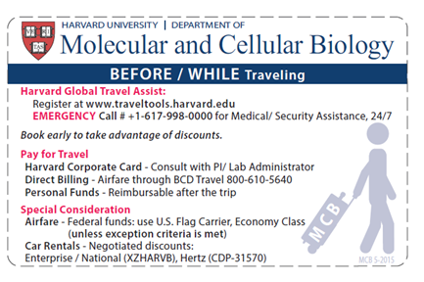
Resources
MCB Travel Reference Card!
Links
  MCB Travel Website
  Harvard Financial Administration Federal Travel Regulations Tutorial
  Financial Policy Office Fellowships vs Reimbursements
  OSP Sponsored Travel Guidance and Policy
  OSP Sponsored Travel Guidance and Policy - Resources
  OSP Sponsored Expenditures Guidelines
  GSA Fly America Act
  US Department of State Open Skies Agreement
Check with your Portfolio Manager ahead of time

Slide 22
Feedback and Discussion
What do you do? Feedback and sharing of helpful practices from lab admins.
What challenges do these new guidelines present to you?

