Slide 1
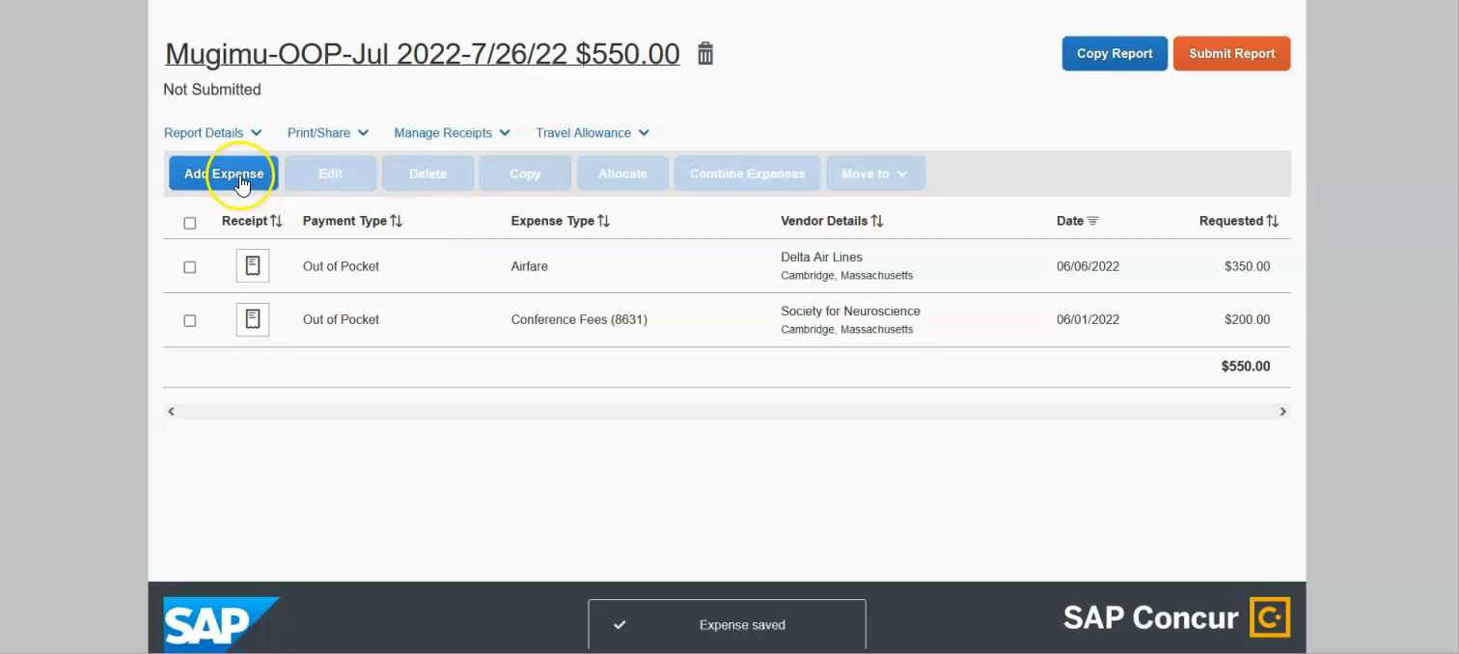
Entering lodging expenses

