Slide 1
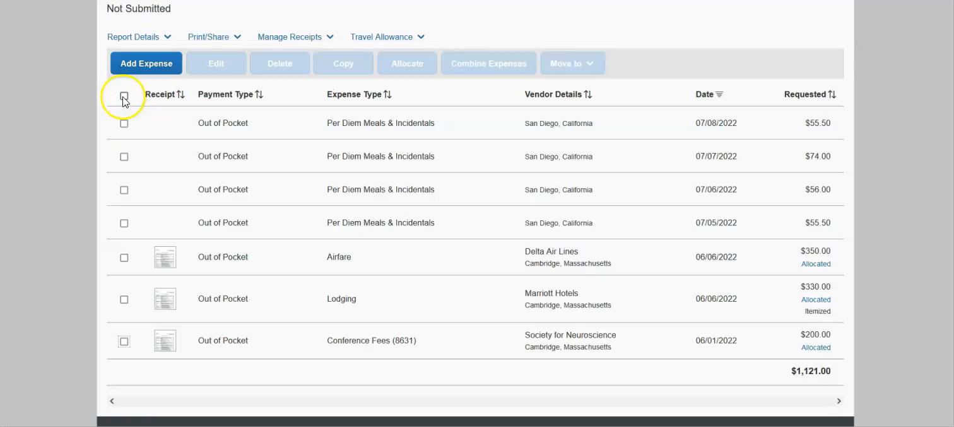
Editing multiple transactions

