Slide 1
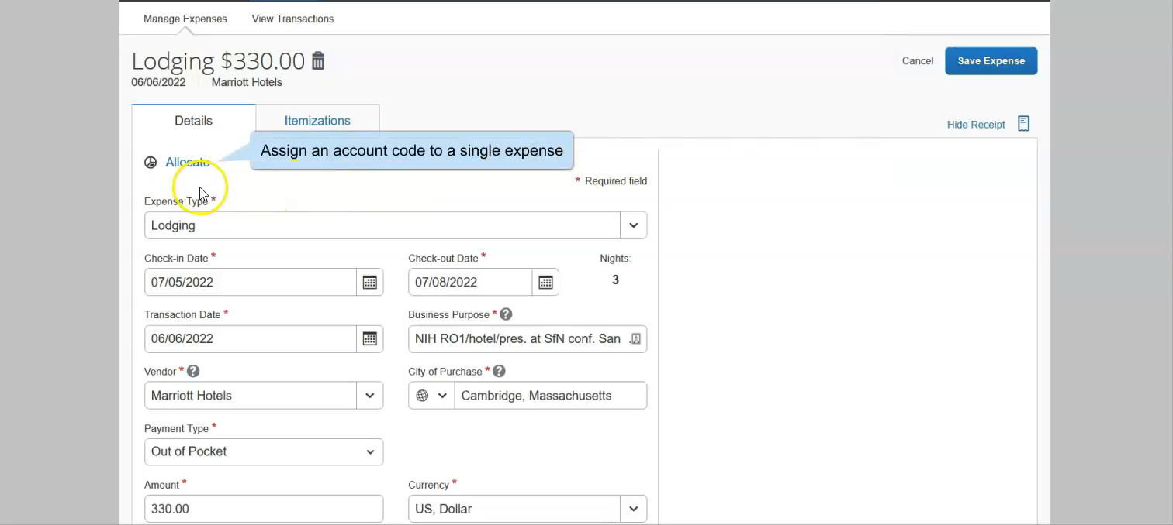
Creating account code favorites

