Slide 1
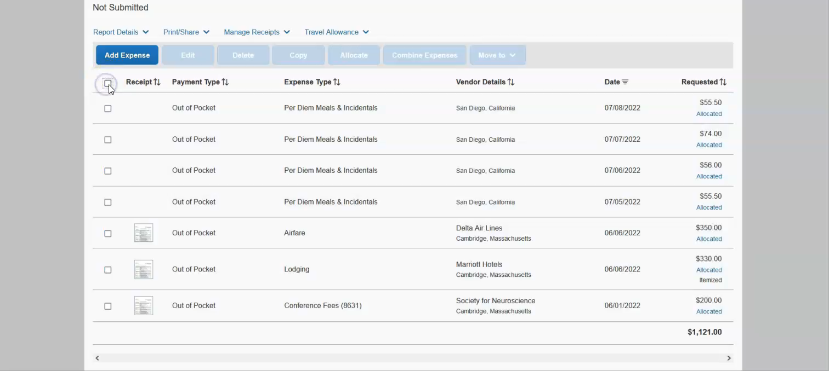
Attaching documents to the report header

